Slide 1
EAP Manager Orientation
1-800-624-5544
https://eap.ndbh.com

Slide 2
The Details: Cost and Confidentiality
Cost:
The EAP is a benefit offered to you and your dependents by your employer at no cost
Up to 6 face-to-face counseling sessions per life challenge/issue per household member and dependent up to age 26 per year (face to face, telephonic or text)
Eligible users:
You, anyone living in your household and dependents outside of the home up to age 26
100% Confidentiality:
No one will know you have used the program unless you give permission to discuss it or tell them yourself

Slide 3
Common Reasons People Use the EAP
Relationship and family challenges
Stress and worries
Life changing events
Elder care concerns
Legal questions
Workplace challenges
Overwhelming anxiety or feeling blue
Substance dependence or addiction
Conflict resolution
Medical issues or illness
Grief or loss
Childcare
Budgeting w/ a financial professional
Support in the proactive or reactive
stage of life’s challenges
800-624-5544

Slide 4

COUNSELING & COACHING
6 Free Face-to-face/Telephonic counseling sessions scheduled with a licensed provider
Unlimited In the moment support 24/7/365
- Crisis intervention & support
Life coaching & resources
6 sessions of Online/Text therapy

Slide 5
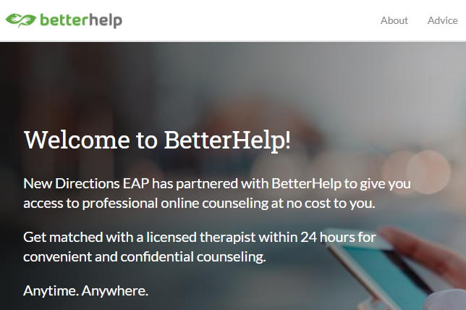
BetterHelp.com/NewDirections

Slide 6

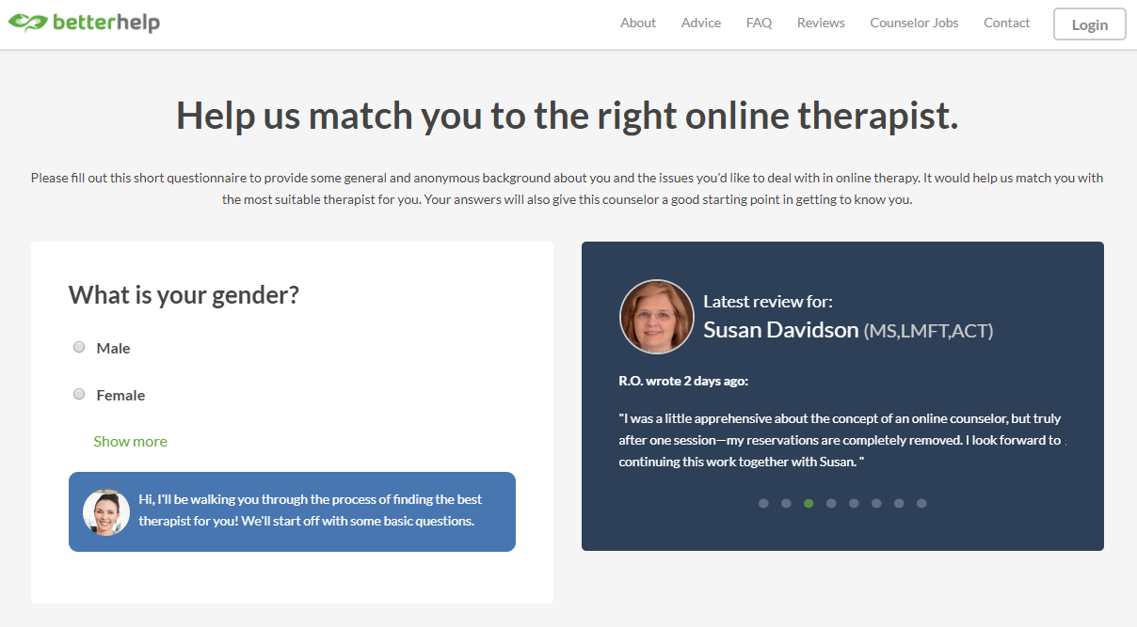
Complete registration and get matched with a therapist Therapist match could take up to 24 hours
Download app and start therapy message, chat, phone, video

Slide 7
Legal Referrals
Free 30-minute consultation with local attorneys
Civil/Consumer Issues
Personal/Family Legal Services
Personal Injury
Criminal Matters
Business Legal Services
Real Estate
IRS Matters
Estate Planning Law
Legal Documents
25% discount off of attorney’s hourly rate

Slide 8
Financial Referrals
Free 30-minute consultation with Financial Counselors & Tax Advisors
Credit Counseling
Debt Consolidation
Budgeting
Tax Issues
Investment Options
Mortgages
Retirement Planning
Online budget planning, calculators and other resources

Slide 9

https://eap.ndbh.com
northeastern university
New updated website!!

Slide 10
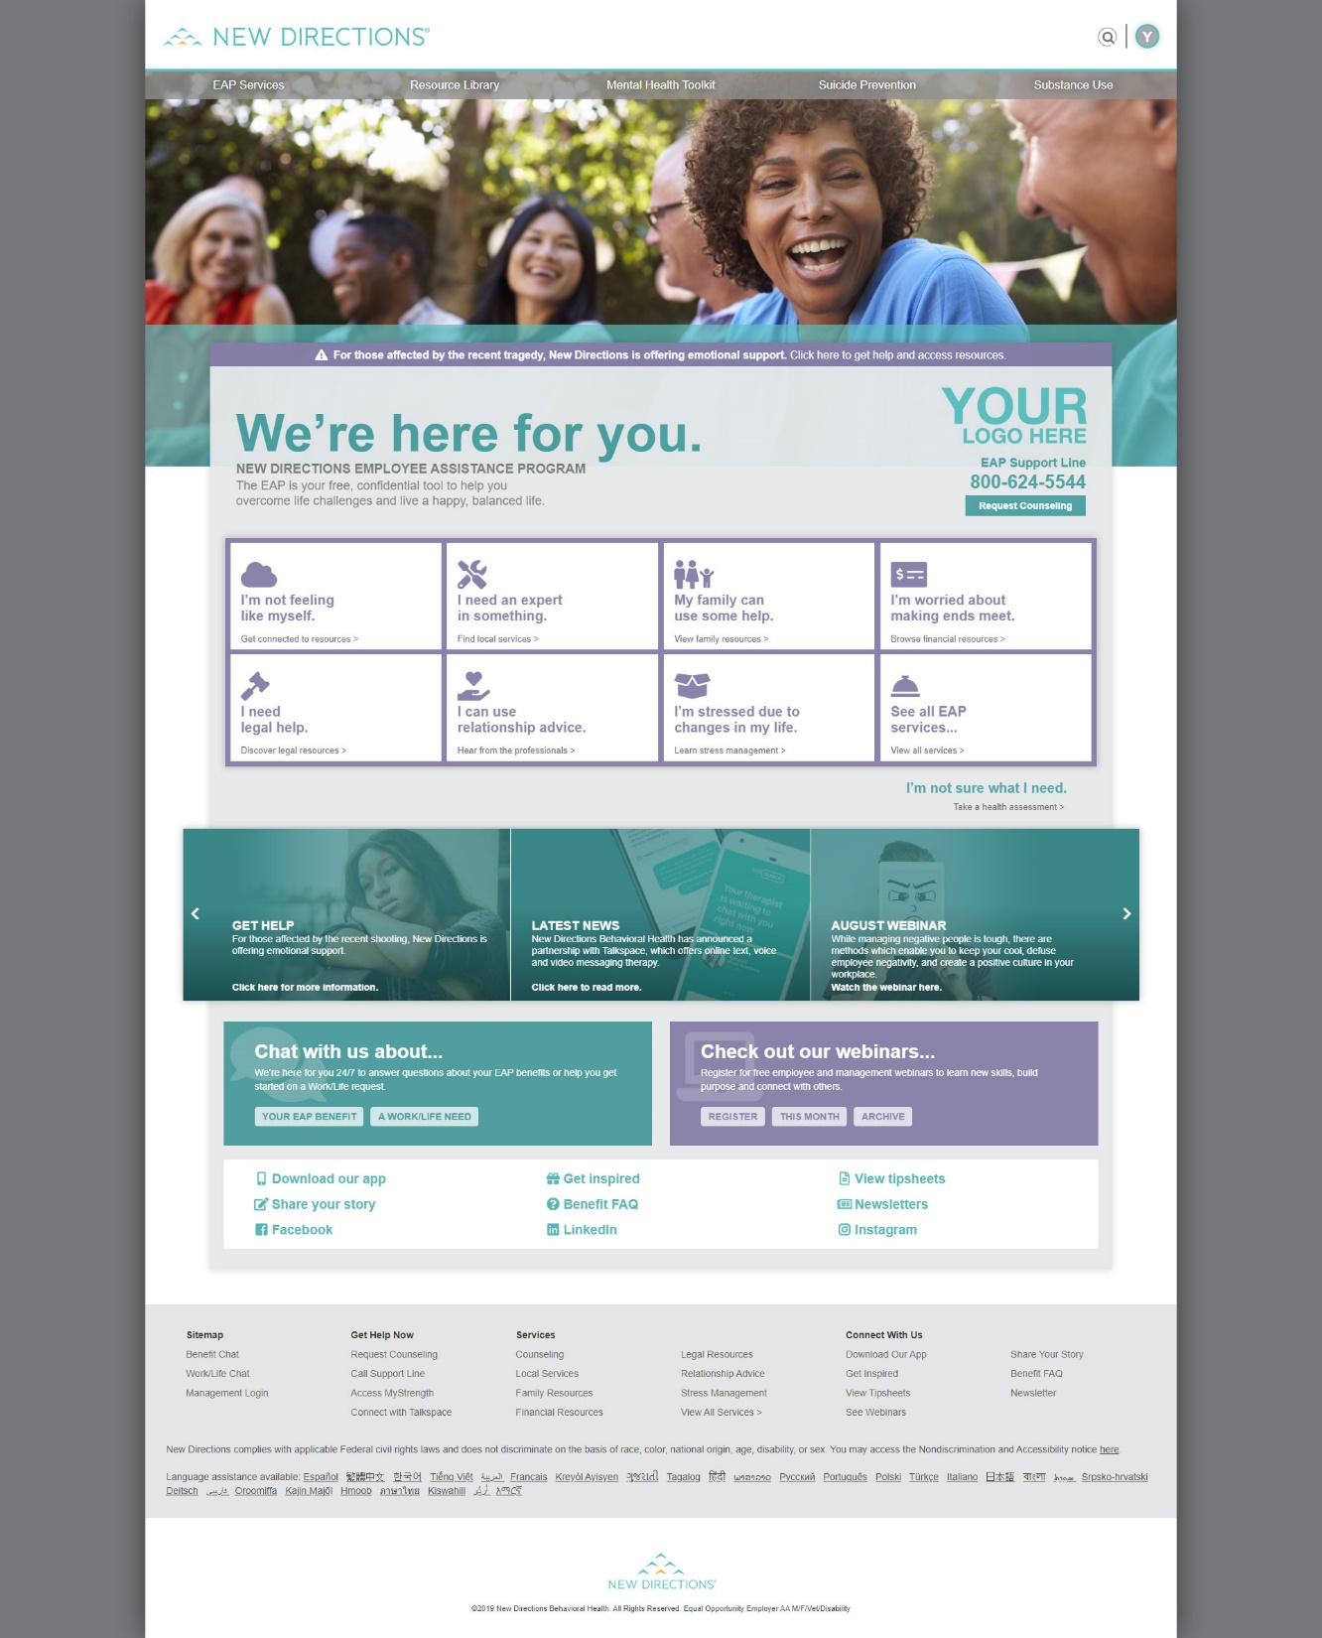



Slide 11
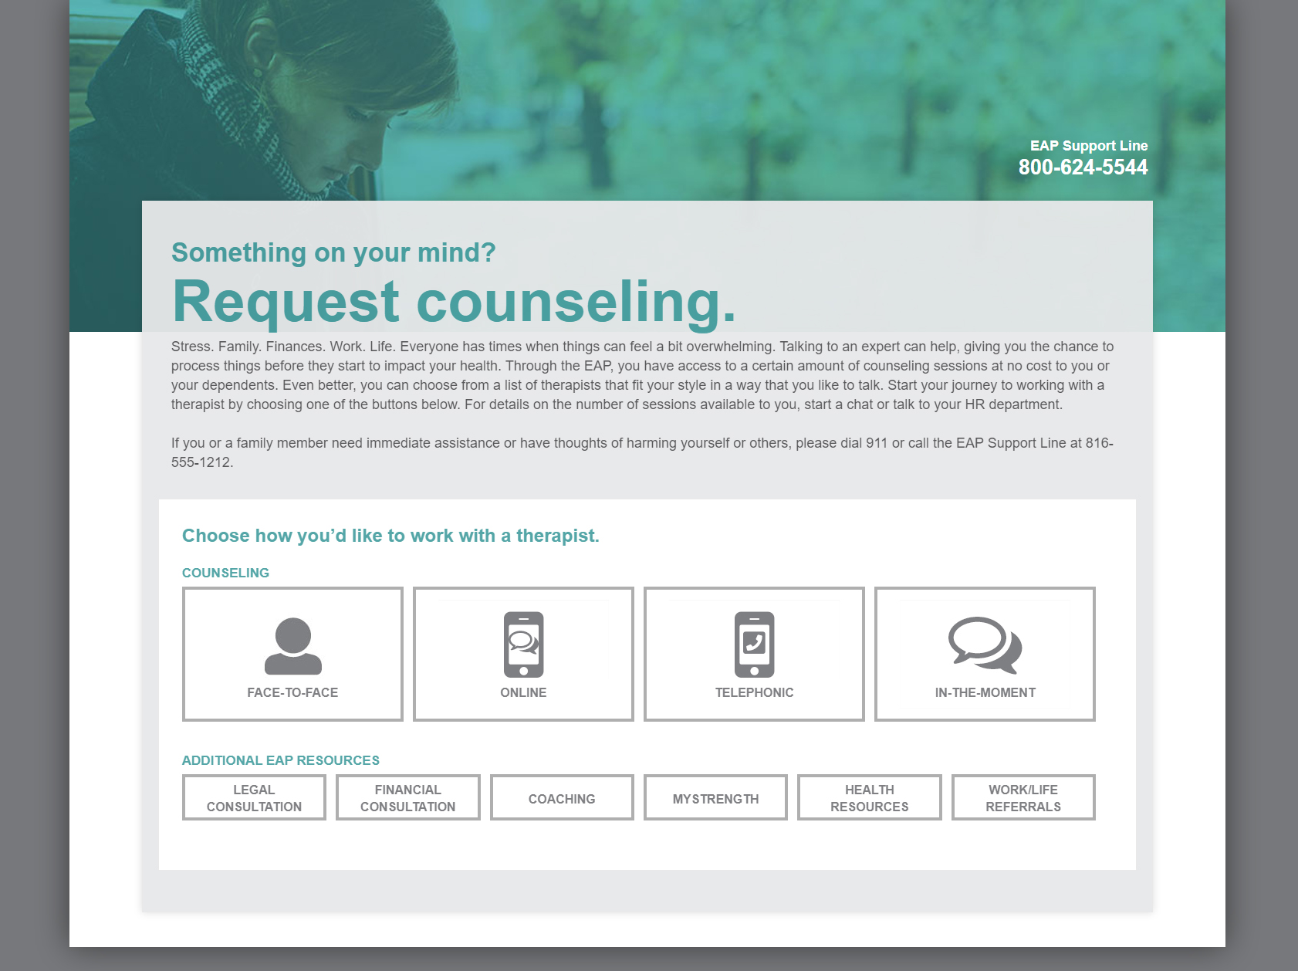

Slide 12
Work-Life Referrals
One phone call reduces stress
Personalized consult with a trained Work-Life specialist
Referral to local providers and national services
Tip sheets
At least 3 referrals i.e. electricians, plumbers, contractors etc.
Consultation, resources and referrals are available for:
Daily living
Child care
Adult care
Elder care
Health and wellness
Education
All of this is available 24/7/365 with one phone call to New Directions.

Slide 13
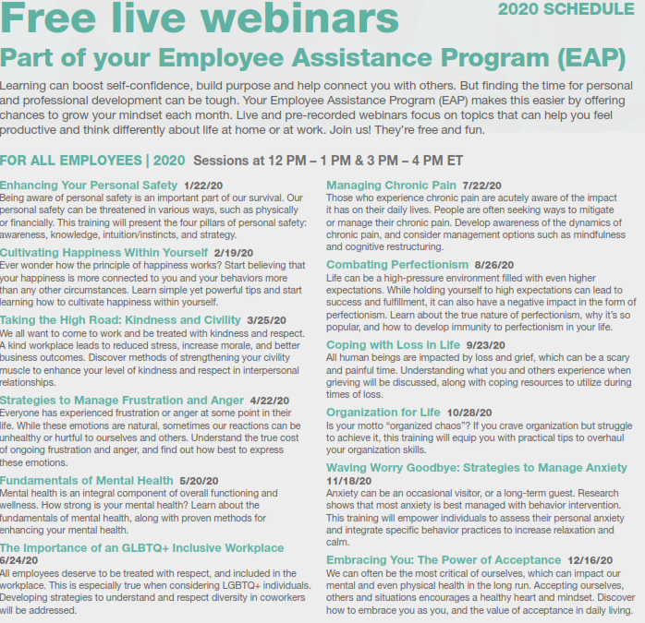
2020 Content calendar for scheduled live monthly webinars

Slide 14
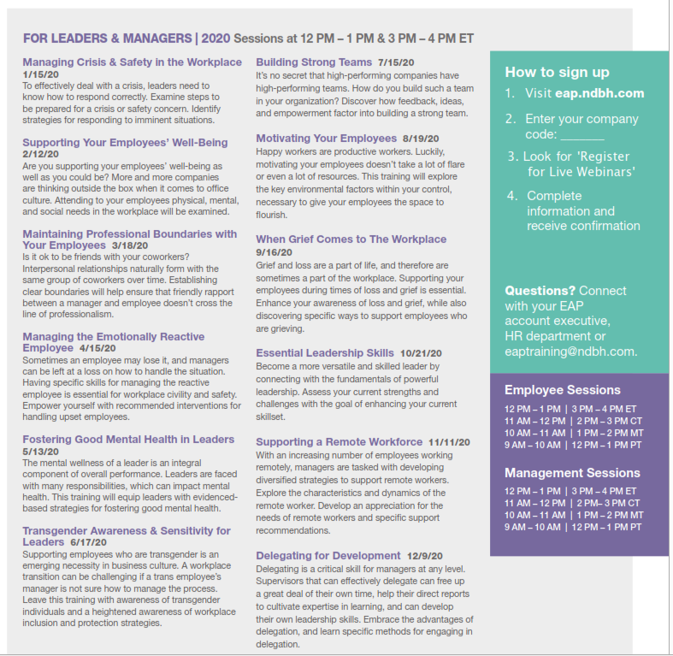
2020 Content calendar for Leadership series

Slide 15
MANAGEMENT
TOOLS

Slide 16
EAP AS A MANAGEMENT TOOL
Recognize and support employees in need
Get your organization and its people through crisis
Best manage employee performance issues
Continuously grow skills to grow your business
Manage people so focus is on work and help retention
Promote, raise awareness and refer to EAP

Slide 17
help identify opportunities to refer to EAP
“I’m feeling sad, overwhelmed, nervous, stressed, no energy, can’t sleep, hopeless, frustrated, angry…”
“My child is being picked on in school. I don’t know what to do”
“My mom died recently, and I don’t know how I am going to handle it”
“My parents can’t take care of themselves anymore, and I’m missing a lot of work”
“My sister has moved in with us, and its not working out. Things are really rough”
“I was in a car wreck and I really want to talk to a lawyer”
“I can’t find a daycare to take care of my child”
“I have been getting calls from collectors at work”

Slide 18
management/HR consultation & support
Management Consultation Support line: One phone call, all your needs
Workplace or community crises | Work performance issues Substance Abuse Issues | Threats to workplace or employees Customer safety issues | Employees in crisis | Fitness for Duty
Dedicated support available 24/7 includes:
Guidance and consultation on any need
Site/situation assessment
Formal process and referrals for employee performance issues
Manager training Coordinated emergency intervention
On-site counseling
Employee resources
Notes:
Dedicated team of specialists via the Management Resource Consultation Team (MRC)
Team approach allows for immediate access 24/7/365
Consultation to assess the situation
Plan of action developed by clinician and immediate support is provided
Intervention, including formal referral, information referral, consult only or on-site support
Tip sheets provided
Follow up on every case

Slide 19
How to Access the EAP
Self referral
Employees call for the appointment
Recommendation
Reminded about EAP benefits
Employee is encouraged to call
Supervisor recommendation
Formal processes
Supervisor or HR initiates referral
Paperwork submitted to EAP
Focus on work performance
The call is confidential

Slide 20
Formal Referral Process*
Always start with calling us first at 800-624-5544 – Press #2
NON-MANDATORY
Strongly recommended
New Directions stays involved to completion
MANDATORY
A requirement of continued employment
New Directions works with HR or Supervisor to promote improved work performance
*Always work with Human Resources
Always requires a Release of Information signed by the Employee

Slide 21

Critical Incident Response Support 24/7
Death of an Employee or other significant loss
Shooting the community
Reduction in Force
Workplace violence
Critical illness of an employee
Call New Directions at (800) 624-5544
Press #2 – Speak to a clinician
To provide in the moment support to the manager/supervisor
Be a sounding board
Send tip sheets
Coordinate onsite support clinical support if needed

Slide 22
HOW YOU GET IN TOUCH

Slide 23

partners for better health
Clinicians available 24 hours a day, 7 days a week
Our clinicians average 15+ years of experience
No time limits on calls
Employees can reach out as often as they need to do so

Slide 24
CONNECT WITH THE EAP
CALL 800-624-5544
In-the-moment support, by-appointment counseling, referrals, financial & legal consultation
TEXT VIA BETTERHELP: www.betterhelp.com/newdirections or click on ‘request counseling” “online” on our website to register.
Short-term counseling
LIVE CHAT – for worklife requests only
Access chat at eap.ndbh.com
ONLINE @ eap.ndbh.com (company code: northeastern university)
Request a counseling session, watch webinars, view helpful articles, visit the legal & financial center
EAP APP (company code: northeastern university)
Request a counseling session, watch webinars, view helpful articles, visit the legal & financial center

Slide 25
Get Started Today
Visit https://eap.ndbh.com
Select For Individual and Family Members
choose Employee Assistance Program
log in using company password: northeastern university
You can:
View thousands of resources on topics
Chat with EAP worklife professionals
Request an EAP session
Set up Online/Text Therapy
Complete your will for free on-line
Access financial and legal tools
We love it when you CALL
1-800-624-5544

